Slide 1
STUDENT NAME: GAYATHRI V
REGISTER NO:312209283
NAAN MUDHALAVAN ID :asunm1353312209283
DEPARTMENT:B.COM ( commerce)
COLLEGE: ANNA ADARSH COLLEGE FOR WOMEN

Slide 2
PROJECT TITLE
Employee Training and development Analysis using Excel

Slide 3

AGENDA
Problem Statement
Project Overview
End Users
Our Solution and Proposition
Dataset Description
Modelling Approach
Results and Discussion
Conclusion
3/21/2024 Annual Review

Slide 4
PROBLEM STATEMENT
Organizations face challenges in managing and tracking employee training and development effectively due to the diverse needs of their workforce and the complexity of data involved.
Difficulty in consolidating training schedules, attendance records, and progress reports into a single, accessible format.
Challenges in accurately tracking individual employee progress, skill development, and training effectiveness, leading to inefficiencies in reporting and analysis.
Difficulty in integrating training data with other HR systems, which can result in manual data entry and increased risk of errors.
Lack of flexibility in existing systems to tailor training plans and reports to specific organizational needs and individual employee requirements.

Slide 5
PROJECT OVERVIEW
Using Excel for employee training and development can be highly effective due to its flexibility and powerful features.
Training Schedules and Calendars: Create and manage training schedules, track sessions, and deadlines. You can use Excel’s calendar templates or create a custom schedule with conditional formatting to highlight important data.
2.Skill Gap Analysis: Design spreadsheets to assess current skill levels versus required competencies. Use tables and charts to visualize gaps and track progress over time.
3.Training Feedback and Evaluation: Collect and analyze feedback from training sessions. Use Excel forms or surveys to gather data, and then analyze responses with pivot tables and charts to gauge the effectiveness of the training.

Slide 6

WHO ARE THE END USERS?
HR Managers: They use Excel to track training schedules, employee progress, and compliance. They also analyze data to make informed decisions about training programs.
Training Coordinators: Responsible for organizing and overseeing training sessions, they utilize Excel to manage logistics, attendance, and feedback.
Line Managers/Supervisors: They use Excel to monitor the development of their team members, review progress reports, and identify areas where additional training may be needed.
Employees: They can benefit from Excel tools that provide a clear view of their training schedules, progress, and personal development plans.
Learning and Development Specialists: They design and implement training programs, using Excel to track effectiveness, manage training materials, and analyze feedback.

Slide 7
OUR SOLUTION AND ITS VALUE PROPOSITION
Centralized Data Management: Excel allows for the centralization of training data, such as schedules, attendance records, and feedback, in one accessible location.
Customizable Tracking: Users can create custom templates and dashboards to track various metrics, including progress, skill development, and certification statuses.
Data Analysis and Reporting: Excel’s powerful data analysis tools, such as pivot tables and charts, enable detailed reporting and visualization of training effectiveness and employee progress.
Flexibility and Customization: Users can design spreadsheets tailored to specific training needs, creating personalized plans and reports based on unique requirements.

Slide 8
Dataset Description
Go to Kaggle and log in to your account. If you don't have an account, you'll need to create one.Select a dataset from the search results. You might want to look at the dataset’s description and preview to ensure it meets your needs Click on the “Download” button, usually located in the upper right corner. The dataset is typically downloaded in a ZIP file format. Locate the downloaded ZIP file on your computer. Extract the contents of the ZIP file. This usually includes one or more files in CSV format.
Employee ID
Name
Training program
Attendance Status
Trainer Name
Feedback Score.

Slide 9
THE "WOW" IN OUR SOLUTION
Interactive Dashboards
Visual Data Representation
Customizable Training Plans
Comprehensive Training Reports
Automated Alerts and Reminders
Data Integration and Analysis
Scenario Analysis
Interactive Training Calendar
3/21/2024 Annual Review
9

Slide 10
MODELLING
Using Excel for modeling employee training and development involves creating structured, interactive, and insightful models to enhance training programs
Define Objectives and Metrics
Data Collection and Structuring
Create a Training Matrix
Build Interactive Dashboards
Analyze Training Effectiveness
Develop a Training Calendar
Scenario and Forecasting Models
Cost-Benefit Analysis
10

Slide 11
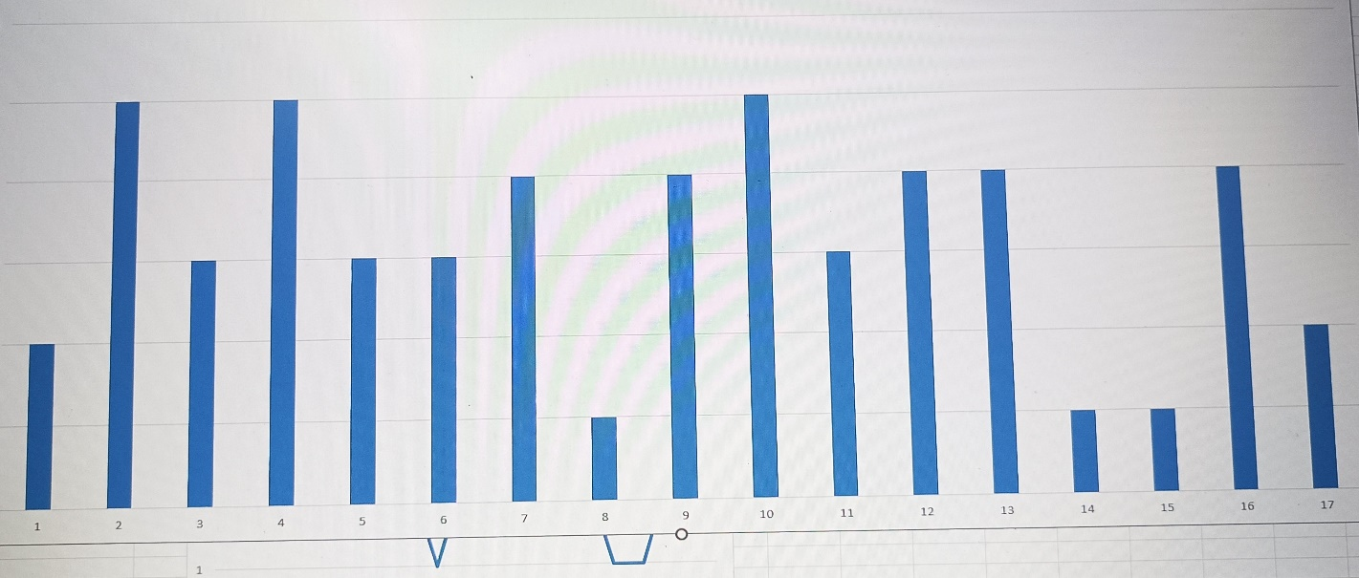
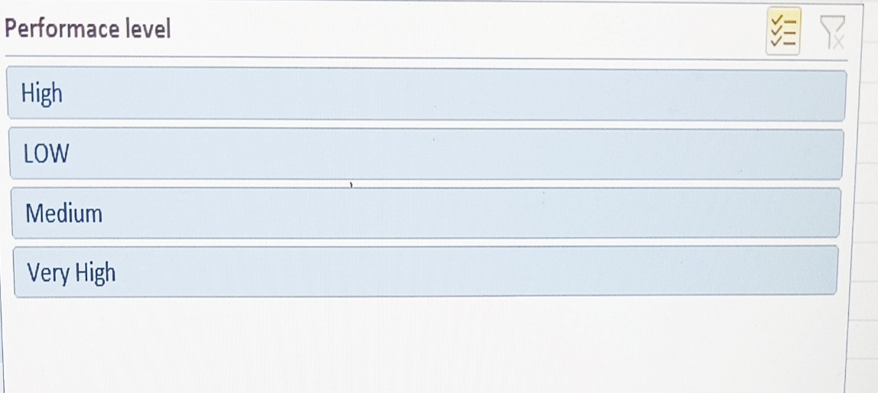
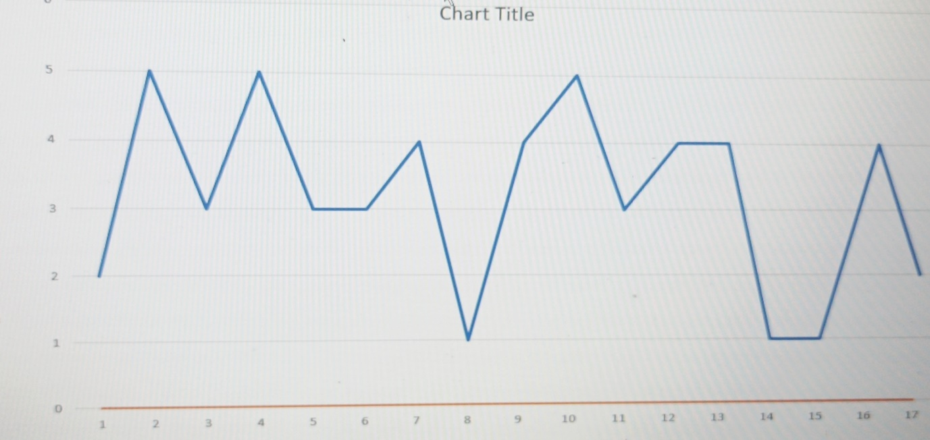
RESULTS
11

Slide 12
conclusion
Utilizing Excel for employee training and development can significantly streamline and enhance your training programs.
Excel allows you to organize and track employee training data systematically, including attendance, progress, and feedback.
Overall, Excel provides a versatile platform for managing employee training and development, offering tools for data organization, analysis, and reporting that can lead to more informed decisions and improved training effectiveness.

